Slide 1

Geometry
Unit 3, Lesson 1 Proving Angle Relations Volume 1, pg. 125

Slide 2


Benchmarks
MA.912.GR.1.1
Prove relationships and theorems about lines and angles. Solve mathematical and real-world problems involving postulates, relationships, and theorems of lines and angles.
MA.912.LT.4.10
Judge the validity of arguments and give counterexamples to disprove statements.
volume 1, pg. 125

Slide 3
Integrated Mathematical Thinking and Reasoning Standards
MA.K12.MTR.1.1 Actively participate in effortful learning both individually and collectively.
MA.K12.MTR.4.1 Engage in discussions that reflect on the mathematical thinking of self and others.
MA.K12.MTR.5.1 Use patterns and structure to help understand and connect mathematical concepts.
volume 1, pg. 125

Slide 4

Learning Targets
I can solve problems that use the relationships of congruent supplements, congruent complements, and vertical angles.
I can use the relationships of congruent supplements, congruent complements, and vertical angles in proofs.
volume 1, pg. 125

Slide 5

Warm-Up
volume 1, pg. 125

Slide 6

3.1.1 Warm-Up: Which One Doesn’t Belong?
Four equations are shown.
Of the four equations, choose one that does not belong.
Explain your reasoning for choosing the equation you did.
$$y=2x$$
$$y=x+9$$
$$y=−4x+2$$
$$y=3x−2$$
volume 1, pg. 125

Slide 7

Exploration
volume 1, pg. 126

Slide 8


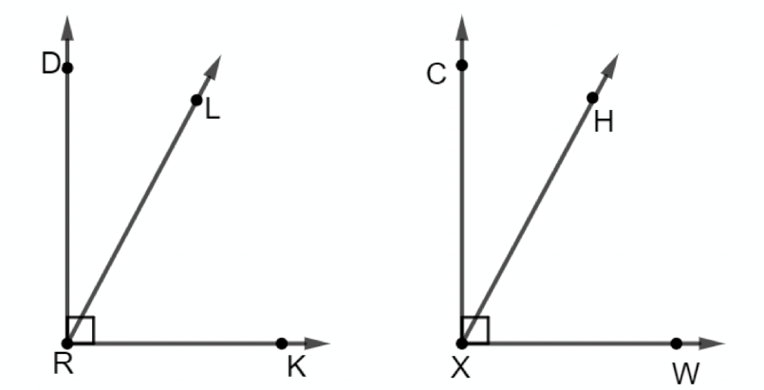

3.1.2 Exploration: Complementary Angles
Complementary angles are two angles whose measures sum to $90°$.
Right angles $DRK$ and $CXW$ are shown. $\vec{RL}$is inside $∠DRK$ and $\vec{XH}$ is inside $∠CXW$. $m∠DRL=28°$ and $m∠CXH=28°$.
volume 1, pg. 126

Slide 9
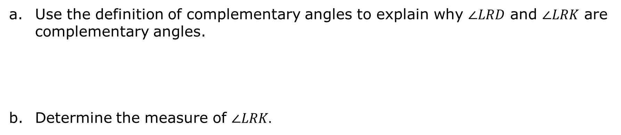
Use the definition of complementary angles to explain why $∠LRD$ and $∠LRK$ are complementary angles.
Determine the measure of $∠LRK.$
volume 1, pg. 126

Slide 10
Discuss with your partner why $m∠HXW$ must be the same as $m∠LRK$. Summarize your discussion.
volume 1, pg. 126

Slide 11
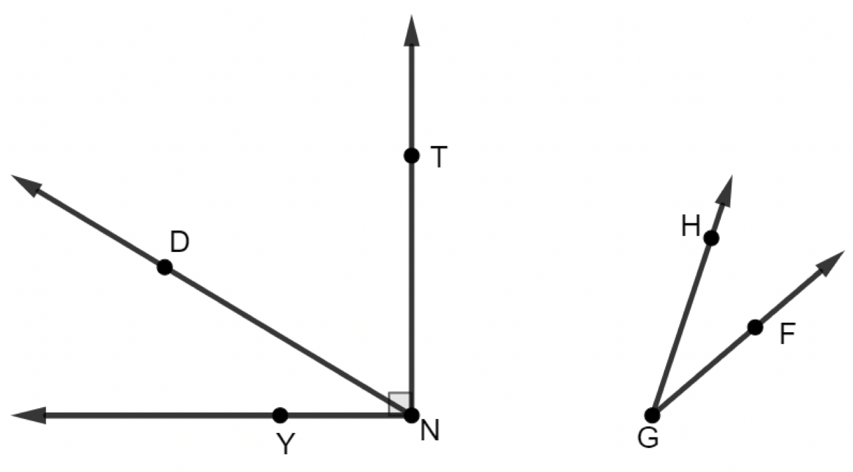
$∠YNT$ and $∠FGH$ are shown. $\vec{ND}$ is inside $∠YNT,$ such that $m∠YND=31°$.
What relationship do $∠YND$ and $∠DNT$ have?
volume 1, pg. 126

Slide 12
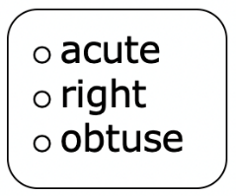

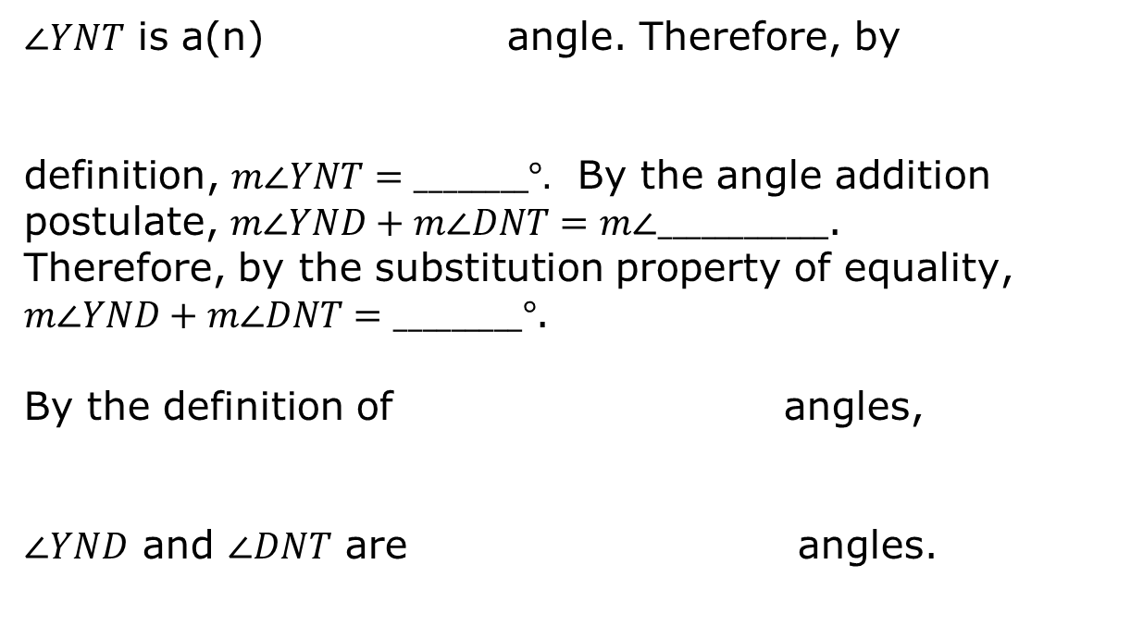
Complete the paragraph proof.
$∠YNT$ is a(n) angle. Therefore, by
definition, $m∠YNT=________°.$ By the angle addition postulate, $m∠YND+m∠DNT=m∠____________$.
Therefore, by the substitution property of equality, $m∠YND+m∠DNT=_________°$.
By the definition of angles,
$∠YND$ and $∠DNT$ are angles.
volume 1, pg. 127

Slide 13

On a piece of patty paper, trace $∠YND$. Determine which rigid transformations can be used to map $∠YND$ onto $∠FGH$.
Use patty paper or a compass to create $∠FGW$ so that $m∠FGW=$ $m∠YNT$ and $\vec{GH}$ is inside of $∠FGW.$
volume 1, pg. 127

Slide 14
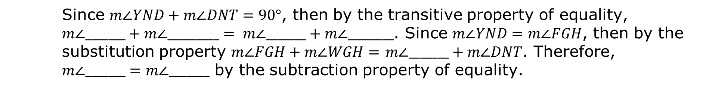
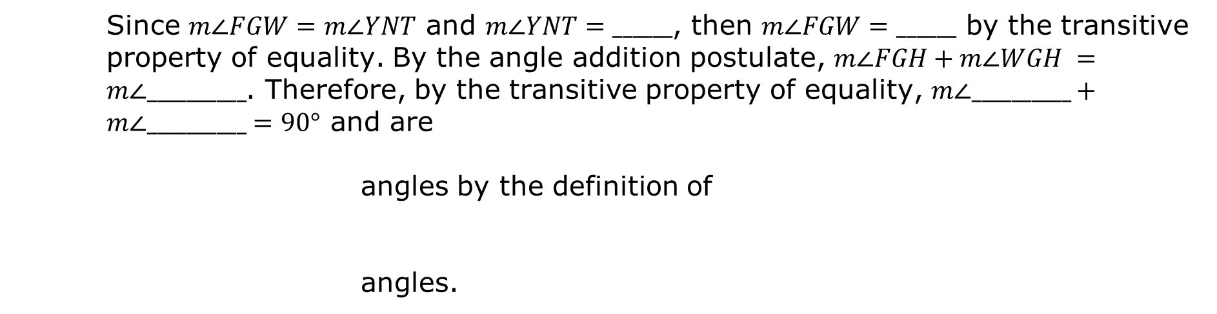
Complete the paragraph proof.
Since $m∠FGW=m∠YNT$ and $m∠YNT=______$, then $m∠FGW=______$ by the transitive property of equality. By the angle addition postulate, $m∠FGH+m∠WGH =m∠__________$. Therefore, by the transitive property of equality, $m∠__________+m∠__________=90°$ and are
angles by the definition of
angles.
Since $m∠YND+m∠DNT=90°$, then by the transitive property of equality, $m∠_______+m∠_________= m∠_______+m∠________$. Since $m∠YND=m∠FGH$, then by the substitution property $m∠FGH+m∠WGH=$ $m∠_______+m∠DNT$. Therefore, $m∠_______=m∠_______$ by the subtraction property of equality.
volume 1, pg. 127

Slide 15

Congruent Complements Theorem
Complements of congruent angles are congruent.
volume 1, pg. 127

Slide 16
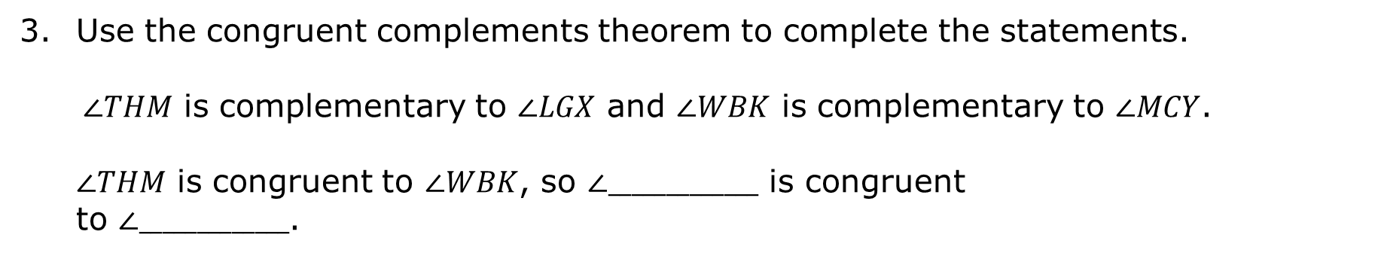
Use the congruent complements theorem to complete the statements.
$∠THM$ is complementary to $∠LGX$ and $∠WBK$ is complementary to $∠MCY$.
$∠THM$ is congruent to $∠WBK$, so $∠_____________$ is congruent
to $∠_____________$.
A corollary is a true statement that is a simple deduction from a theorem or postulate. Its proof requires only a few simple statements in addition to the proof of the original theorem or postulate.
Corollary to Congruent Complements Theorem
Complements of the same angle are congruent.
volume 1, pg. 128

Slide 17
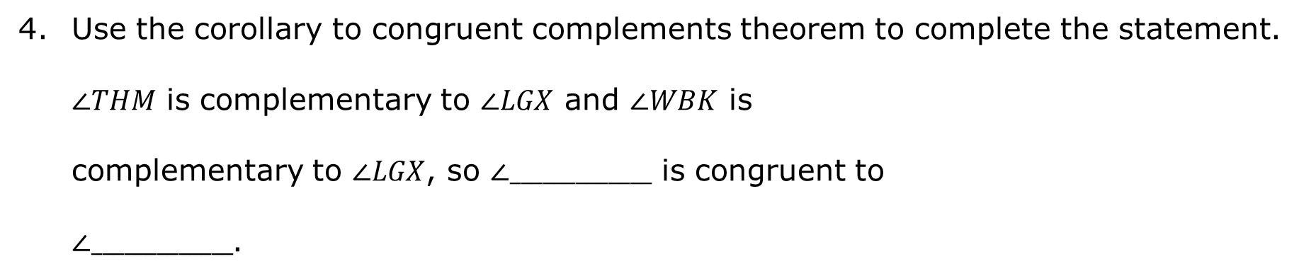
Use the corollary to congruent complements theorem to complete the statement.
$∠THM$ is complementary to $∠LGX$ and $∠WBK$ is
complementary to $∠LGX$, so $∠_____________$ is congruent to
$∠_____________$.
volume 1, pg. 128

Slide 18
Exploration
volume 1, pg. 128

Slide 19
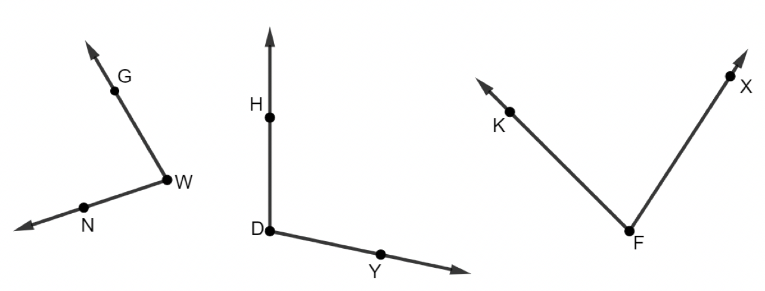

3.1.3 Exploration: Supplementary Angles
Supplementary angles are two angles whose measures sum is exactly $180°$.
$∠GWN$, $∠HDY$, and $∠KFX$ are shown. $∠GWN$ is supplementary to $∠HDY$. $∠KFX$ is supplementary to $∠HDY$.
volume 1, pg. 128

Slide 20
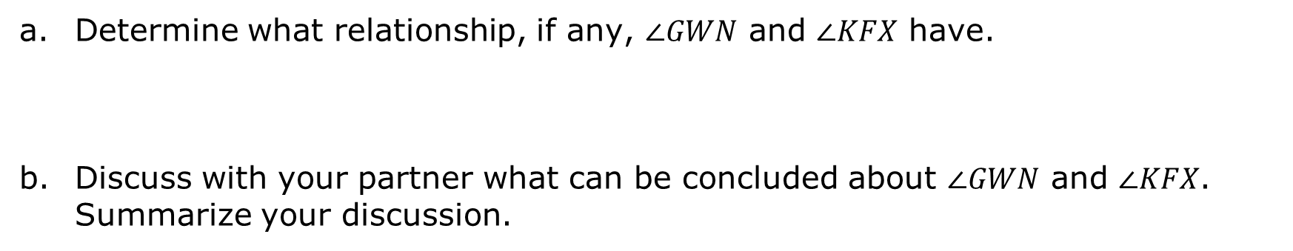
Determine what relationship, if any, $∠GWN$ and $∠KFX$ have.
Discuss with your partner what can be concluded about $∠GWN$ and $∠KFX$. Summarize your discussion.
volume 1, pg. 128

Slide 21

Ask two classmates their conclusion about $∠GWN$ and $∠KFX$. Record their conclusion and write your summary of their reason. You are the only person who should write in the first two columns of the table. Have the person initial next to your summary stating that your summary was correct.
Discuss your classmates’ conclusions with your partner.
Conclusion | My Summary of Their Reason | Initials
volume 1, pg. 129

Slide 22
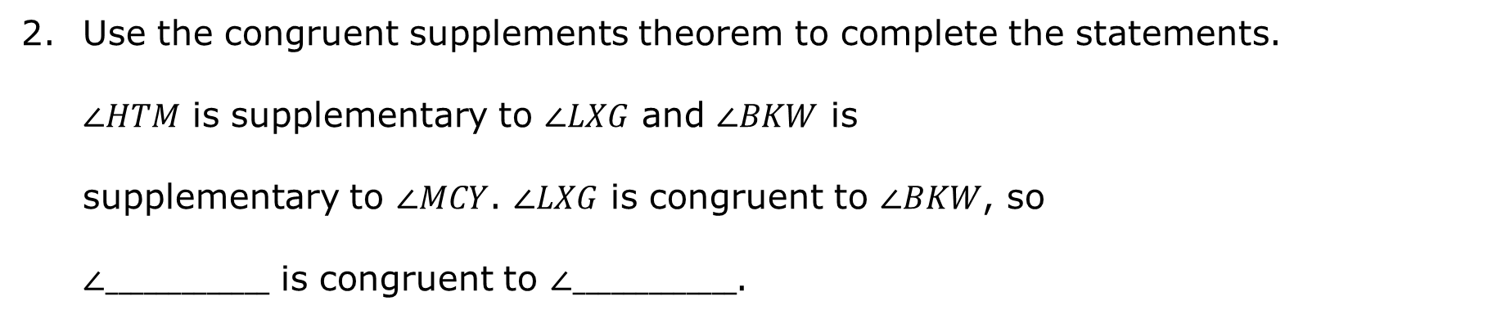
Congruent Supplements Theorem
Supplements of congruent angles are congruent.
Use the congruent supplements theorem to complete the statements.
$∠HTM$ is supplementary to $∠LXG$ and $∠BKW$ is
supplementary to $∠MCY$. $∠LXG$ is congruent to $∠BKW$, so
$∠_____________$ is congruent to $∠_____________$.
volume 1, pg. 129

Slide 23
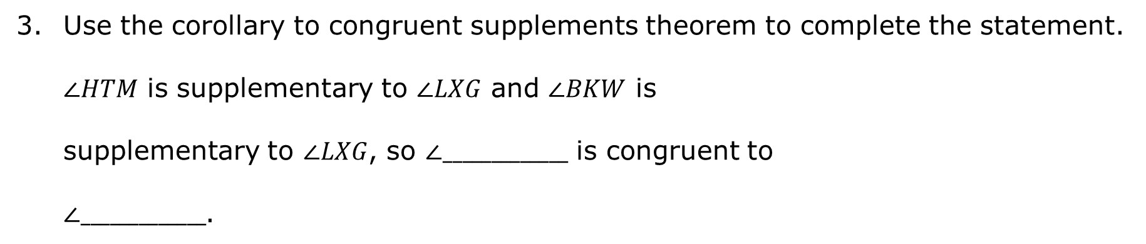
Corollary to Congruent Supplements Theorem
Supplements of the same angle are congruent.
Use the corollary to congruent supplements theorem to complete the statement.
$∠HTM$ is supplementary to $∠LXG$ and $∠BKW$ is
supplementary to $∠LXG$, so $∠_____________$ is congruent to
$∠_____________$.
volume 1, pg. 129

Slide 24

Guided Instruction
volume 1, pg. 130

Slide 25
3.1.4 Guided Instruction: Angles
Two adjacent angles that form a straight angle are called a linear pair.
A linear pair is two adjacent angles formed by two intersecting lines.
Linear Pair Postulate
If two angles form a linear pair, then they are supplementary.
volume 1, pg. 130

Slide 26
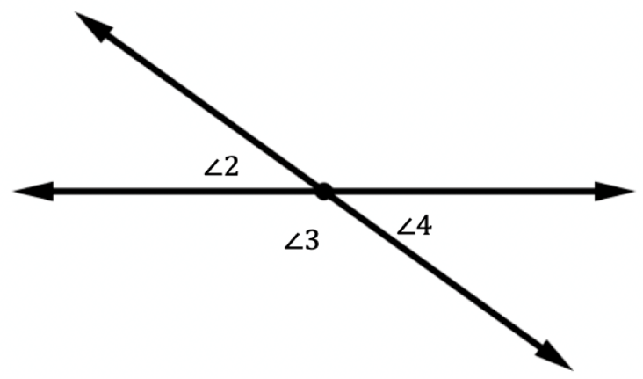
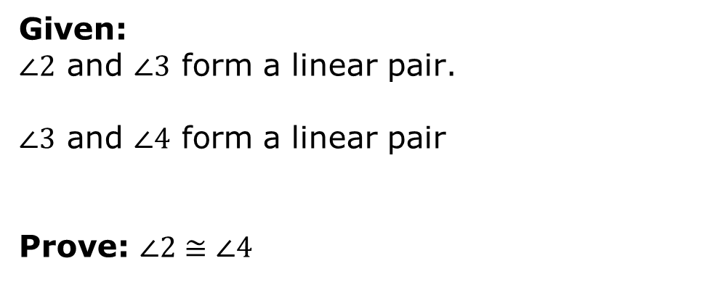
Use the phrases in the word bank to complete the proof. Some phrases may be used more than once.
Word Bank
Definition of Linear Pair | Linear Pair Postulate
Supplements of the same angle are congruent. | Complements of the same angle are congruent.
Given:
$∠2$ and $∠3$ form a linear pair.
$∠3$ and $∠4$ form a linear pair
Prove: $∠2≅∠4$
volume 1, pg. 130

Slide 27
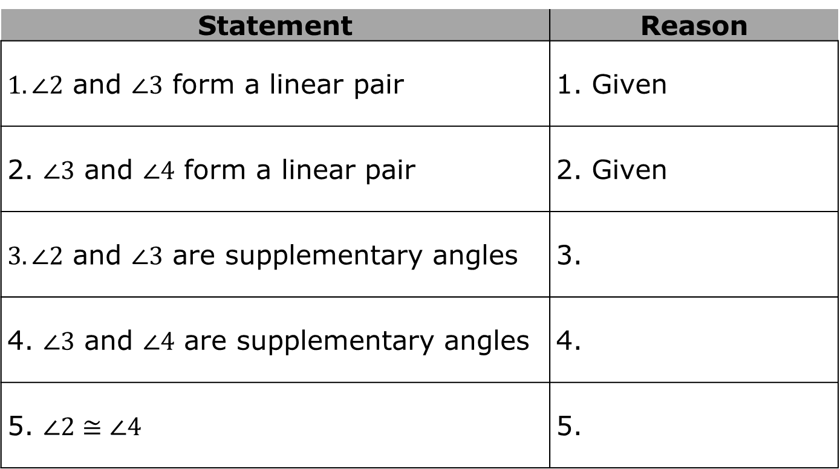
Statement | Reason
$1. ∠2$ and $∠3$ form a linear pair | 1. Given
2. $∠3$ and $∠4$ form a linear pair | 2. Given
$3. ∠2$ and $∠3$ are supplementary angles | 3.
4. $∠3$ and $∠4$ are supplementary angles | 4.
5. $∠2≅∠4$ | 5.
volume 1, pg. 130

Slide 28
Vertical angles are the opposite angles formed when two lines intersect.
$∠2 \text{and} ∠4$ are also known as _______________ angles.
Vertical Angles Theorem
If two lines intersect, then vertical angles are congruent.
volume 1, pg. 131

Slide 29

Try It
volume 1, pg. 131

Slide 30

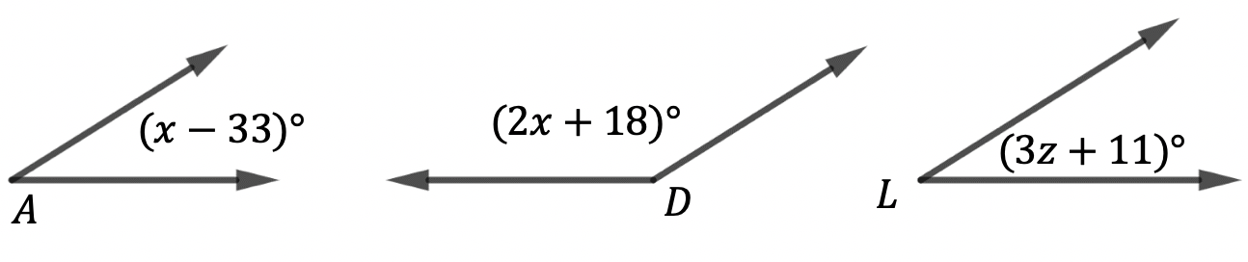

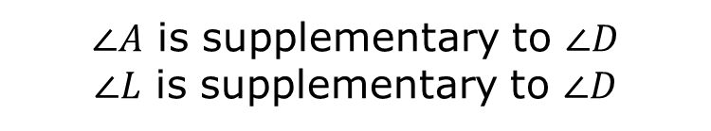
3.1.5 Try It: Solving Problems Using Angle Relationships
Three angles are shown with the given information.
$∠A$ is supplementary to $∠D$
$∠L$ is supplementary to $∠D$
What is the value of $z$?
volume 1, pg. 131

Slide 31
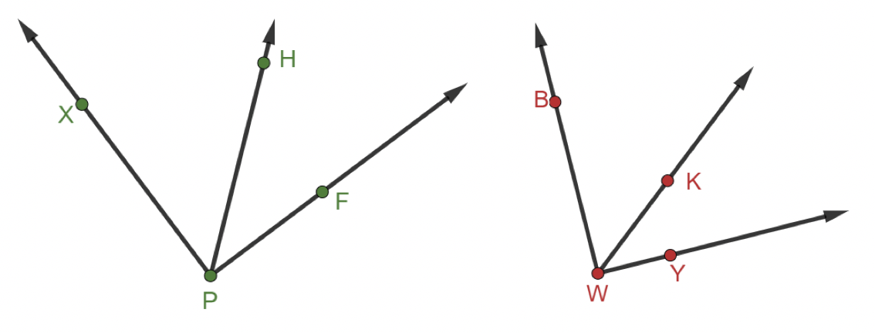

Right angles $XPF$ and $∠BWY$ are shown. $\vec{PH}$ is inside $∠XPF$, such that $m∠HPF=39°$. $m∠HPF=m∠KWY$.
What is $m∠BWK$?
volume 1, pg. 131

Slide 32

Wrap-Up
volume 1, pg. 132

Slide 33
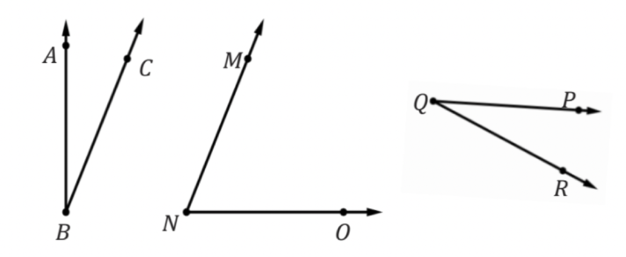
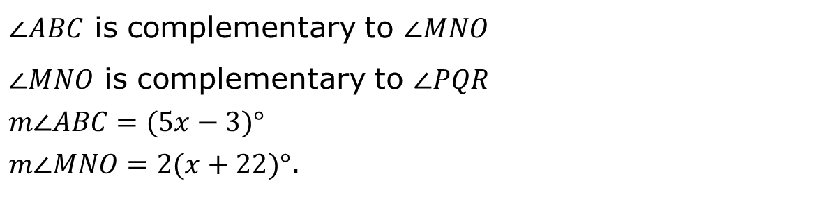
3.1.6 Wrap-Up: Cool Down
Three angles are shown with the given information.
$∠ABC$ is complementary to $∠MNO$
$∠MNO$ is complementary to $∠PQR$
$$m∠ABC=(5x−3)°$$
$m∠MNO=2(x+22)°$.
volume 1, pg. 132

Slide 34
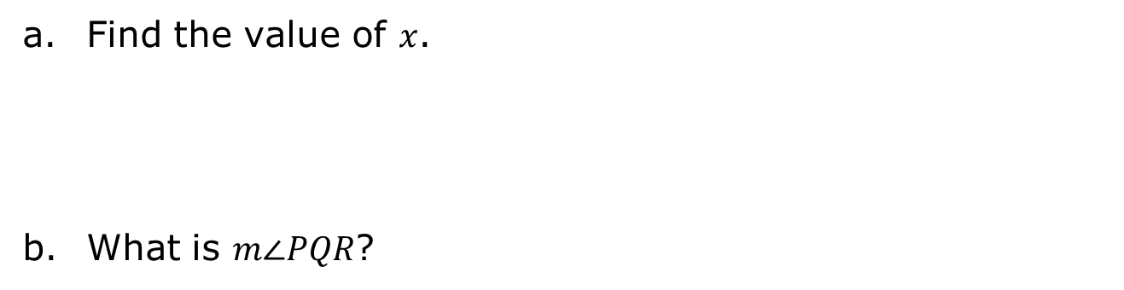
Find the value of $x$.
What is $m∠PQR$?
volume 1, pg. 132

